Slide 1
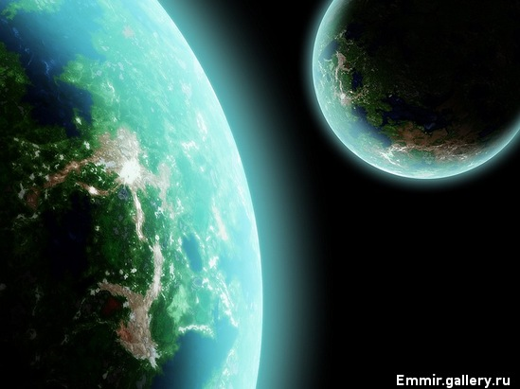
The Earth needs a friend, doesn't it?

Slide 2

We discuss
People’s health
Air pollution
Water pollution
Land pollution
Endangered plants, animals

Slide 3
Ecological problems
The word “ecology” came from Greek word which means “home”.
Water | is | thrown away
Air |  | destroyed
Forests |  | killed
Animals | are | polluted
Wildlife |  | spoiled
Litter |  | cut down
Health

Slide 4
Ecological problems
?
?
?

Slide 5
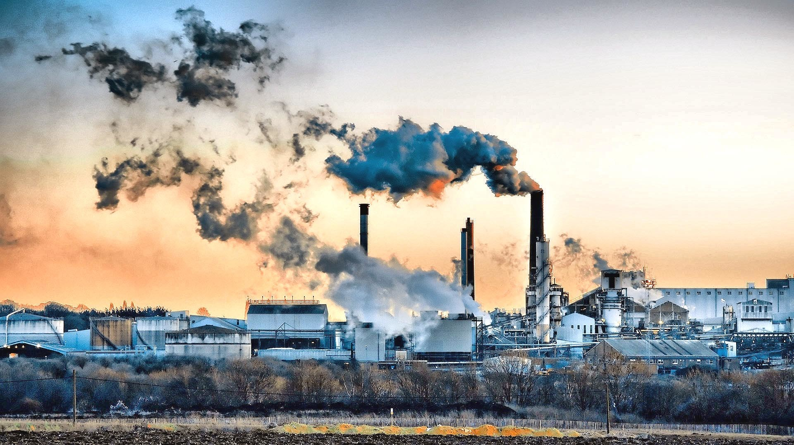
... factories

Slide 6
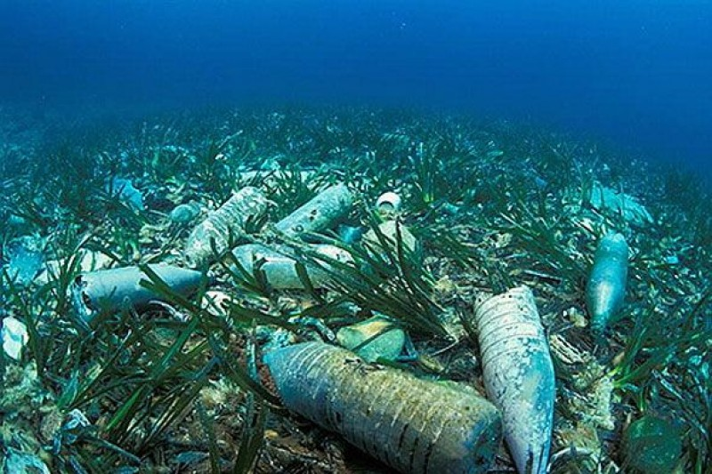
... rubbish

Slide 7
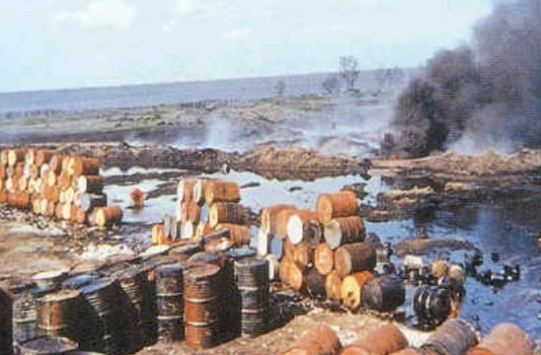
Water is .... by ...

Slide 8
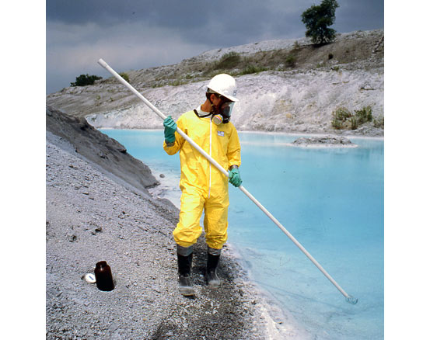
This man is wearing ...

Slide 9
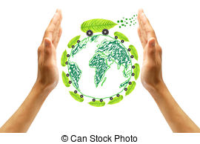
We should ...

Slide 10
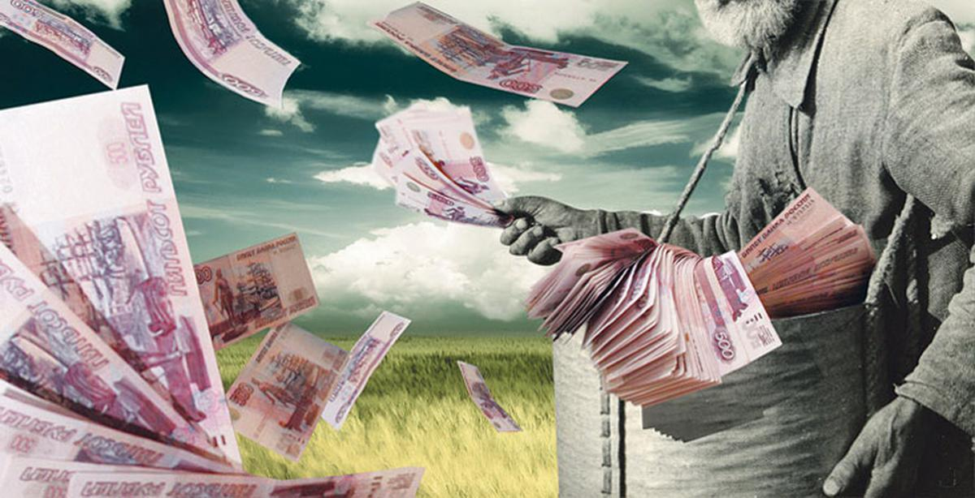
... of money

Slide 11
What are the results of our influence on the environment?
Make up one sentence using passive voice.
We leave a fire. We destroy the forest.
When the fire is left, the forest is destroyed.
We pollute the air. - We change the climate.
We throw away plastic bottles. - We damage nature.
We leave litter in the forest. - We hurt animals.
We don’t recycle paper. - We cut down trees.
We break trees. - We disturb birds.
We throw litter in the river. - We cause water pollution.
We leave glass bottles in the forest. - We hurt animals and people.

Slide 12
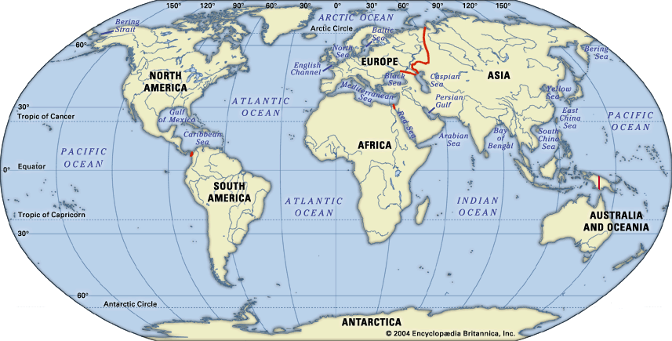
Continents
Rivers & lakes
Countries
Channels,
Oceans &
Seas
Islands
Cities
Mountains
We use “THE”
We don’t use “THE”
The Russian Federation
The United States
of America
The United Kingdom
Europe Asia Australia
Russia Spain
Great Britain
Lake Baikal
Madagascar
The English Channel
The Pacific Ocean
The Black Sea
The Volga
The Baikal
The Bahamas
The British Isles
London Moscow
The Urals
The Alps
Everest Elbrus

Slide 13
___ Ob ___ Baltic Sea
___ Mississipi
___ Nile
___ Amazonka
___English Channel
___ Lake Baikal
___ Lake Ontario
___ Michigan
___ Balhash
___ Philippines
___ Russian Federation
___ Norway
___ Africa
___ Tomsk
___ Bora-Bora
___ Phucket
___ Bermuda islands
___ Azores (islands)

Slide 14
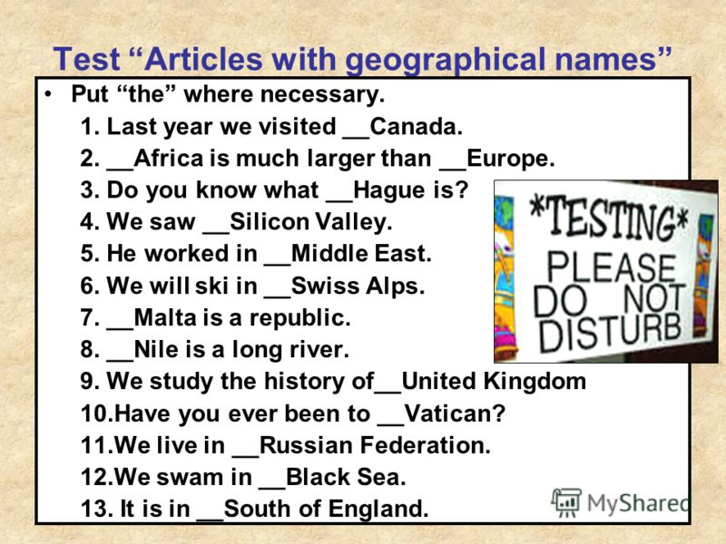
2

Slide 15
1)… Andes are the mountains in … South America.
2) … London is the capital of … United Kingdom.
3) In summer lots of people prefer to go to … south.
4)… Caribbeans are situated to … southeast of … USA.
5) … lake Baikal is the largest lake in the world.
6) They plan to visit several countries during their vacation in … Europe: … France, … Italy, … Netherlands, … Spain.
7) … Saint-Petersburg is considered to be the cultural capital of … Russian Federation.
8)The channel between England and France is called … English Channel.
9) … Lena leads to … Arctic Ocean.
10) … Adriatic Sea separates … Italy from … Balkan Peninsula.
11) Ann had to cross … Atlantic Ocean to get from … Europe to … Argentine.
12) The northernmost point of … Russian Federation is … Cape Chelyuskin.

Slide 16
Answer the questions
What forms of life are there on the Earth?
Why have many species of birds and animals disappeared?
What is the air polluted by?
Why are the rivers empty of fish?
Why are the forests disappearing all over the world?
Can you see pollution at the seaside?
People are in danger, aren't they?
What do people pollute besides the environment? Is it more serious?

Slide 17
find the synonyms from the text
amazing
people
die out
nature around us
make
vital problems
forecast
wonderful
human beings
disappear
environment
create
serious problems
prediction

Slide 18
find the synonyms from the text
frightening
unhealthy food
rubbish
everywhere
damage
gases
alarming
junk food
litter
all over
destroy
fumes

Slide 19
Vocabulary
- physical harm that is done to something
Environment -
- to make air, water, the ground dirty
to pollute -
- to prevent something from touching or harming something
to protect -
- the natural world that people, animals, and plants live in
to prohibit -
to damage -
- to keep someone or something safe from harm, damage or illness
to keep off -
- to say that an action is illegal or not allowed

Slide 20
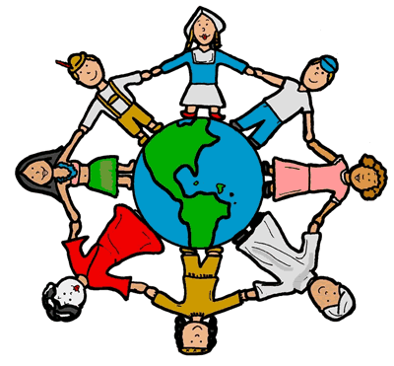
Homework
SB p. 59 (57) ex.17 письм.

